Slide 1

Quadcopter Drone Simulation
Team #08
Final Project
Ashish Bhogate, Dheeraj Kumar, Dhrumil Shah, Prasad Borkar
MAE 506
Advanced System Modeling, Dynamics, and Control
Arizona State University

Slide 2
Agenda
Team #08
Introduction
Modeling
Methods and Simulation
Simulation Results
Conclusions and Discussions
Controller Design for Self-Stabilizing Lab Cart
MAE 506 Advanced System Modeling, Dynamics, and Control

Slide 3
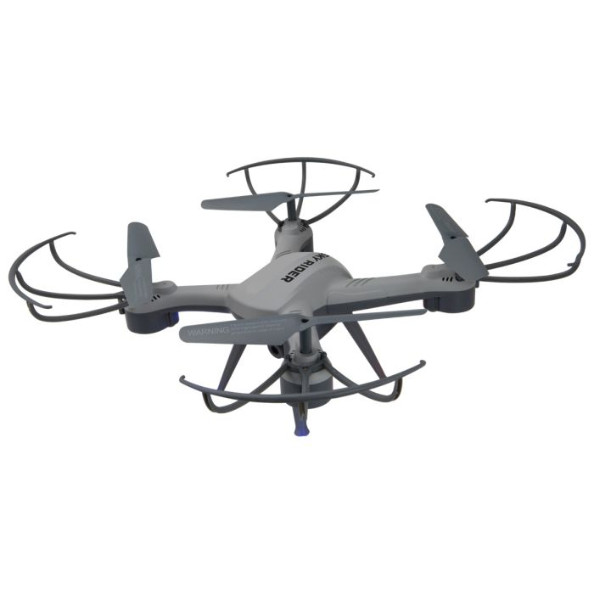
Introduction
Team #08
Explored drone flight principles and controller roles through research papers.
Flying of drone is depends on many factors: Roll, Pitch, Yaw, Position X, Position Y, Position Z.
Studied two conditions (3 DOF and 6 DOF) for comprehensive understanding.
Opted for Z-direction focus due to design complexity and class scope
Controller Design for Self-Stabilizing Lab Cart
MAE 506 Advanced System Modeling, Dynamics, and Control
Notes:
The two biggest factors that influence the safety and efficiency of lab work are ease of access to materials and proper use of lab space. Bulky lab carts are often favored because they can hold a lot of tools and move around, but that just means they get in the way. Smaller carts present a different danger because bumping into them can potentially harm lab workers, depending on what tools are left on them. The Lab Buddy self stabilizing lab cart aims to find the sweet spot between these issues, reducing the space a lab cart takes without risking being toppled over.

Slide 4
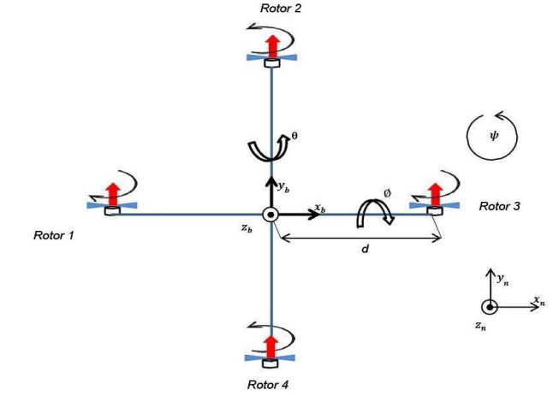
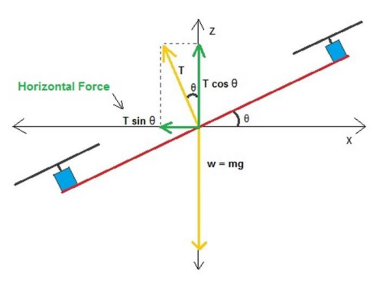
Free Body Diagram
Assumptions
Team #08
Two parts:
Main Quadcopter body (M,d)
Rotor body (m,r)
Considering mass of rotor body = 1 gm
Value of c = 1
Controller Design for Self-Stabilizing Lab Cart
MAE 506 Advanced System Modeling, Dynamics, and Control
Notes:
SCRIPT
We began the project by creating a Free Body Diagram of our system, which is essentially an inverted pendulum on wheels
The system is made up of two parts; the pendulum body and the cart body. The cart body is made up of two wheels and a shaft connecting them. The pendulum body is everything else in the system rotating about the axis of rotation, which is along the shaft.
The design parameters that were needed for the controller design were (List off each parameter w/ a short description)
We arbitrarily chose the upward vertical to be zero degrees. It made sense to us that the controller would constantly aim for ϴ to be zero instead of 𝛑. Either method works.
The only friction we calculated for was friction from the ground
We defined the datum to be along the center of the cart’s center of mass. This was important when calculating the potential energy of the system

Slide 5
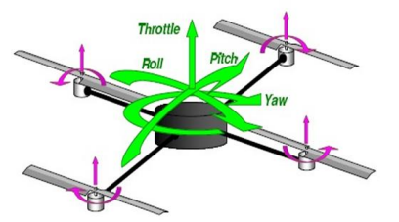
Quadcopter Dynamics
Team #08
Quadcopter Modelling
Roll Motion
Pitch Motion
Yaw Motion
Vertical Motion
Horizontal Motion
Controller Design for Self-Stabilizing Lab Cart
MAE 506 Advanced System Modeling, Dynamics, and Control
Notes:
SCRIPT
We derived our equations of motion using the Euler-Lagrange method
Using the FBD created, we began by analyzing the kinematics of the pendulum’s center of mass. x_{p} and y_{p} are the positions of the pendulum’s center of mass while x is the x-position of the cart’s body
Next, we calculated the kinetic energies and potential energies of the system, which allowed us to get equation one
Because we are assuming ground friction, we included friction using Rayleigh’s Dissipation Function. This is necessary for linear velocity-dependent dissipative forces
We then replaced q with x and ϴ in equation three, giving us two nonlinear equations of motion
In order to linearize the equations, we used the small angle approximation. Our goal was to keep the pendulum body from going past 25° on either side of the upward vertical. This approximation, seen in equation 4, simplified the two nonlinear equations to two linear equations.
Notice how ɸ is defined as the small approximation angle. ɸ will be used instead of ϴ from this point forward

Slide 6
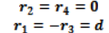
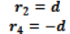

Roll Motion
Team #08
Pitch Motion
Yaw Motion
1
2
3
r (Moment arm) is distance of individual forces from x-axis
r (Moment arm) is distance of individual forces from y-axis
Modeled as Tz, and reactive torque is Q
Q =
If i th rotor is Counterclockwise
Q =
If i th rotor is Clockwise
Controller Design for Self-Stabilizing Lab Cart
MAE 506 Advanced System Modeling, Dynamics, and Control

Slide 7
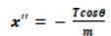
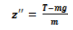
Vertical Motion
Team #08
5
Horizontal Motion
4
Motion is governed by total thrust force ‘T’ and weight ‘w’ along z- axis
Motion in the x & y-axes is accomplished by decreasing the rpm of the rotor
By Newton’s second law equation,
Similarly y’’ can be derived as,
Controller Design for Self-Stabilizing Lab Cart
MAE 506 Advanced System Modeling, Dynamics, and Control

Slide 8
Quadcopter Modelling
3 DOF
6 DOF
Roll angle (Φ)
Pitch angle (θ)
Yaw angle (Ψ)
Roll rate (Φ’)
Pitch rate (θ’)
Yaw rate (Ψ’)
Position along x axis (x)
Position along y axis (y)
Position along z axis -height (z)
Velocity along x axis (x’)
Velocity along y axis (y’)
Velocity along z axis (z’)
Roll angle (Φ)
Pitch angle (θ)
Yaw angle (Ψ)
Roll rate (Φ’)
Pitch rate (θ’)
Yaw rate (Ψ’)
Controller Design for Self-Stabilizing Lab Cart
MAE 506 Advanced System Modeling, Dynamics, and Control
Notes:
SCRIPT
With the two linear equations, we were able to write them in state-space form and put them into MATLAB
Our only output interest is in ɸ, so C only has a 1 corresponding with ɸ

Slide 9
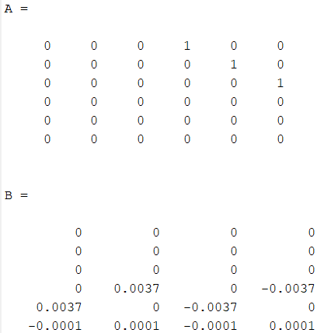
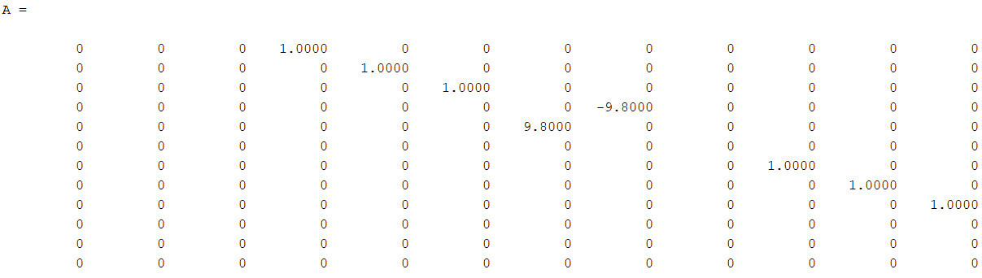
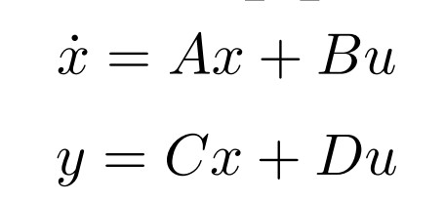
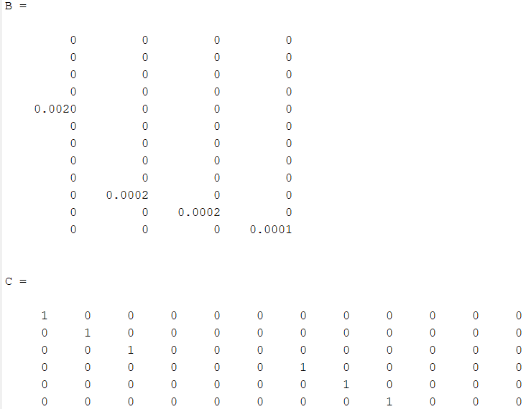
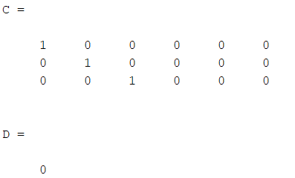
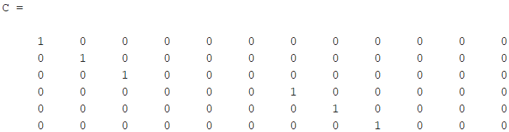
After simplifying State Space Model input to Matlab ↓
Team #08
State Space Representation
3 DOF
6 DOF
Controller Design for Self-Stabilizing Lab Cart
MAE 506 Advanced System Modeling, Dynamics, and Control
Notes:
SCRIPT
With the two linear equations, we were able to write them in state-space form and put them into MATLAB
Our only output interest is in ɸ, so C only has a 1 corresponding with ɸ

Slide 10
Team #08
r
+
u
x
y
G
-
K
u = -Kx + Gr

Slide 11
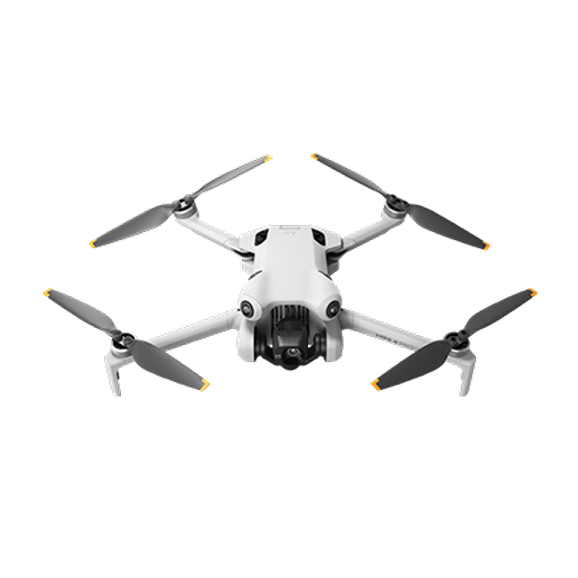
Variables
Team #08
Var. | Definition | Value
M | Drone mass | 500 gm
R | Radius of drone body | 5 cm
m | Rotor mass | 1 gm
c | Force to moment scaling factor | 1 (Unitless)
d | Length between m and M | 22.5 cm
g | Gravity Constant | 9.8 m/s²

Slide 12
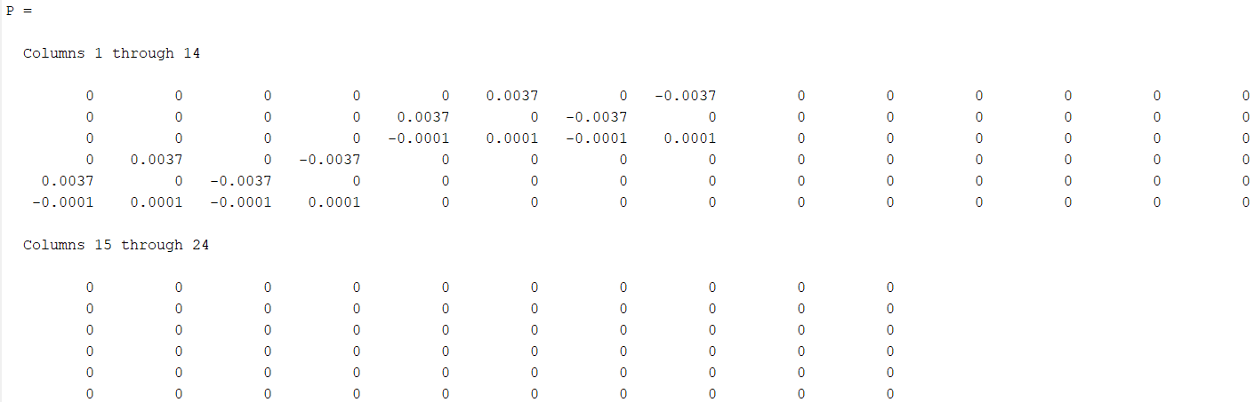
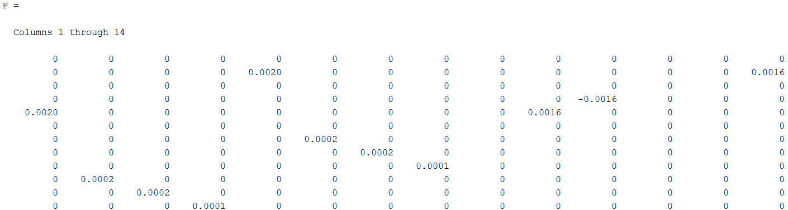
Controllability
Team #08
3 DOF
6 DOF
Step 1: Checking controllability of the System
We compute controllability matrix as follows
P = [B AB A^2B… A^6B]
Rank(P) = 6
Our system is controllable!
Step 1: Checking controllability of the System
We compute controllability matrix as follows
P = [B AB A^2B… A^12B]
Rank(P) = 10
Our system is not controllable!
Controller Design for Self-Stabilizing Lab Cart
MAE 506 Advanced System Modeling, Dynamics, and Control

Slide 13
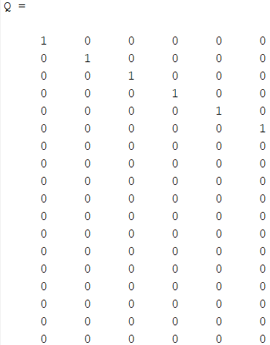
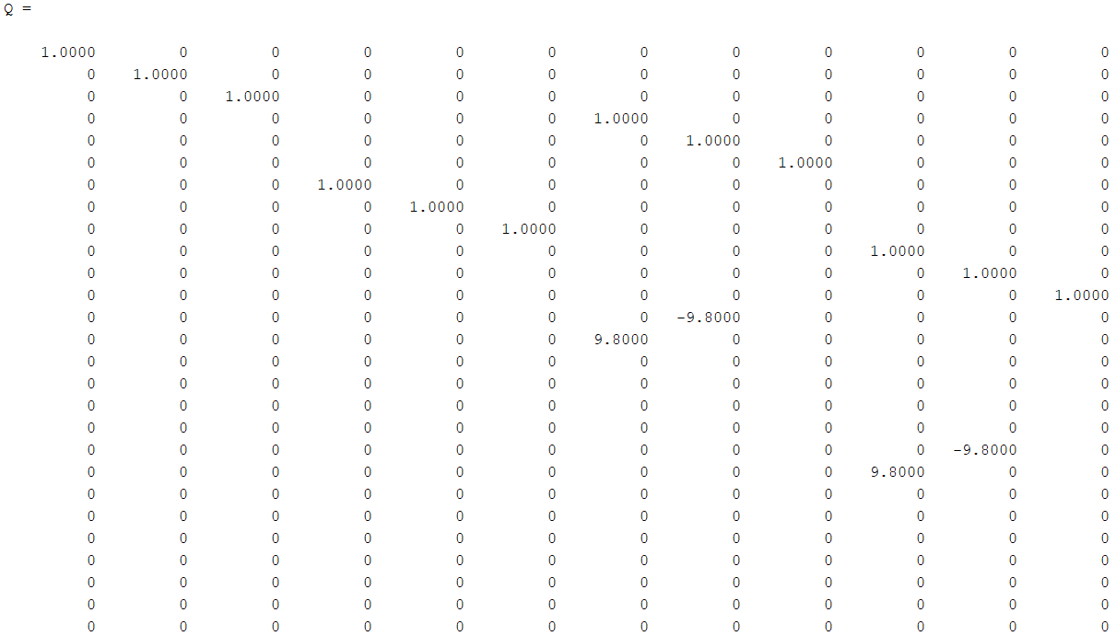
Observability
Team #08
3 DOF
6 DOF
Step 2: Checking observability of the System
We compute observability matrix as follows
Q = [C CA CA^2… CA^6]’
Rank(Q) = 6
Our system is Observable!
Step 2: Checking observability of the System
We compute observability matrix as follows
Q = [C CA CA^2… CA^12]’
Rank(Q) = 12
Our system is Observable!
Controller Design for Self-Stabilizing Lab Cart
MAE 506 Advanced System Modeling, Dynamics, and Control

Slide 14
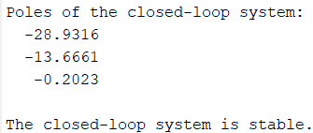
Team #08
Stability
Step 3: Checking stability of the System
We need to find the eigenvalues of A
|λ*I-A| = 0
We have 3 eigenvalues ≤ 0, so the system is STABLE!
Integration of PID controller made the closed loop response stable.
Controller Design for Self-Stabilizing Lab Cart
MAE 506 Advanced System Modeling, Dynamics, and Control

Slide 15
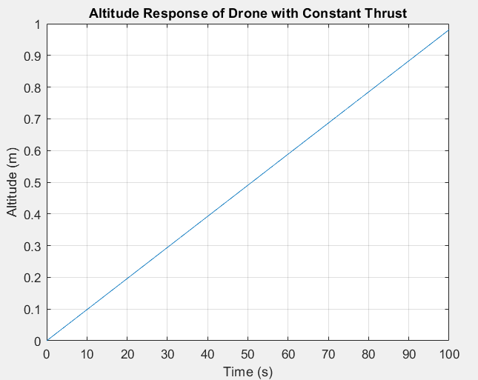
Open Loop Response
Team #08
Simulation State Model using Lsim
With the applied thrust, the drone takes off and the position is not controlled.
Controller Design for Self-Stabilizing Lab Cart
MAE 506 Advanced System Modeling, Dynamics, and Control

Slide 16
Z axis
Team #08
Importance of Z-Axis Dynamics:
Vertical motion control is pivotal for achieving hovering, a state of equilibrium
Crucial for lift-off, altitude maintenance, and stability.
Defines the quadcopter's ability to achieve and sustain vertical motion.
Implementation of State-space representation becomes more manageable when focusing solely on vertical dynamics.
Approach of Isolation of Z axis allows for a deeper understanding of the quadcopter's fundamental dynamics.
Application
Vertical control is crucial for aerial vehicles, especially in applications like surveying and aerial photography.
Controller Design for Self-Stabilizing Lab Cart
MAE 506 Advanced System Modeling, Dynamics, and Control

Slide 17
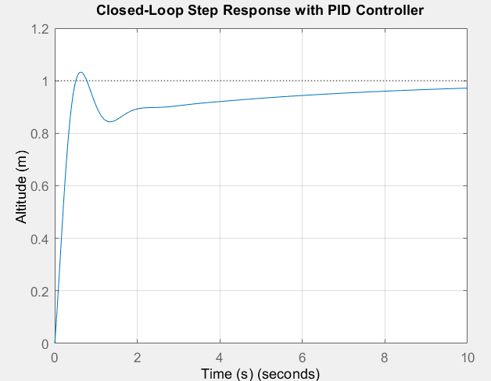
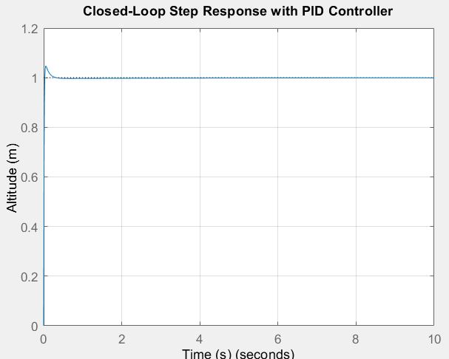
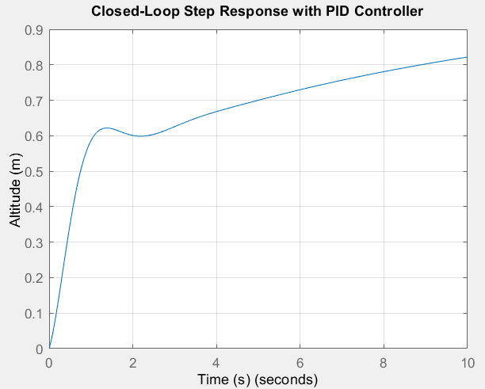
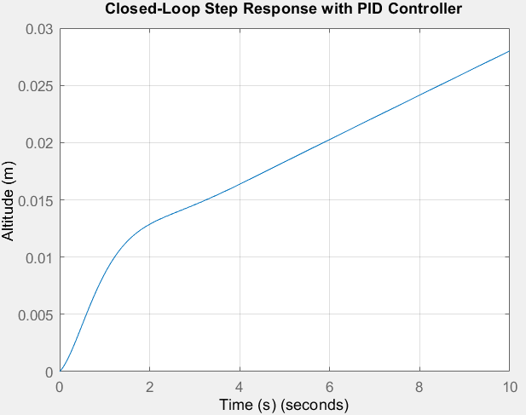
Closed Loop Response with PID Controller
Team #08
eig_des2 = [ -0.9999,-1, -1.00001,-10]
K = 1.0e+04 * [ -0.0250 -0.0774 -3.5397 -3.1696]
eig_des2 = [ -0.19999, -2, -2.00001, -20]
K = 1.0e+04 * [-0.0399 -0.2415 -8.4342 -8.5804]
Higher K
As K ↑ => Settling time ↓
As K ↑ => Overshoot ↑
K = 1
K = 2.5
Lower K
eig_des4 = [ -10,-9.9999, -10.00011,-100]
K = 1.0e+07 *[ -0.2347 -0.0742 -6.7091 -2.0503]
eig_des3 = [ -0.39999, -4, -4.00001, -40];
K = 1.0e+05 *[ -0.0639 -0.1932 -4.6291 -5.6977]
K = 0.05
K = 0.001
Controller Design for Self-Stabilizing Lab Cart
MAE 506 Advanced System Modeling, Dynamics, and Control

Slide 18
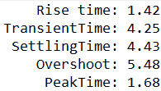
Performance Characteristics
Team #08
Goals:
% OS less than 10%
Avoid overcorrection
Settling time 3s < ts < 5s
Do not want to adjust gain value too quickly
Do not want heavy oscillations to persist
In future can control rise time as well
Controller Design for Self-Stabilizing Lab Cart
MAE 506 Advanced System Modeling, Dynamics, and Control

Slide 19
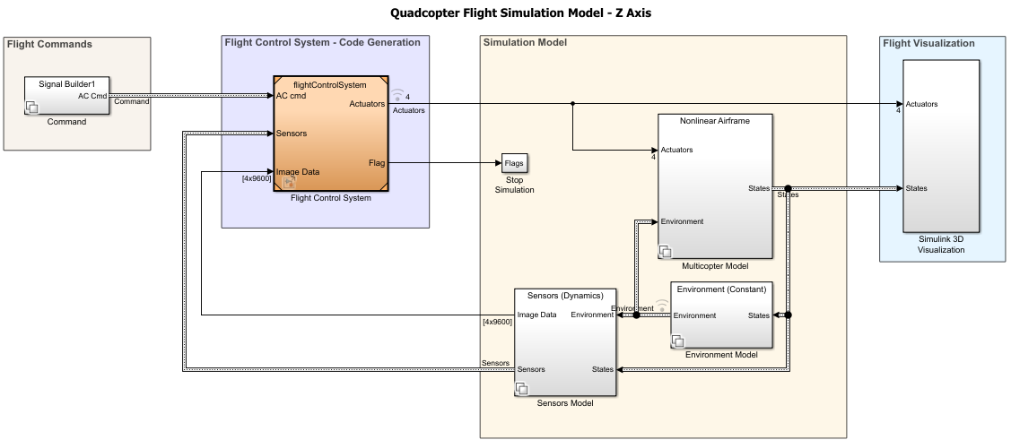
Team #08
Matlab Simulink Model

Slide 20
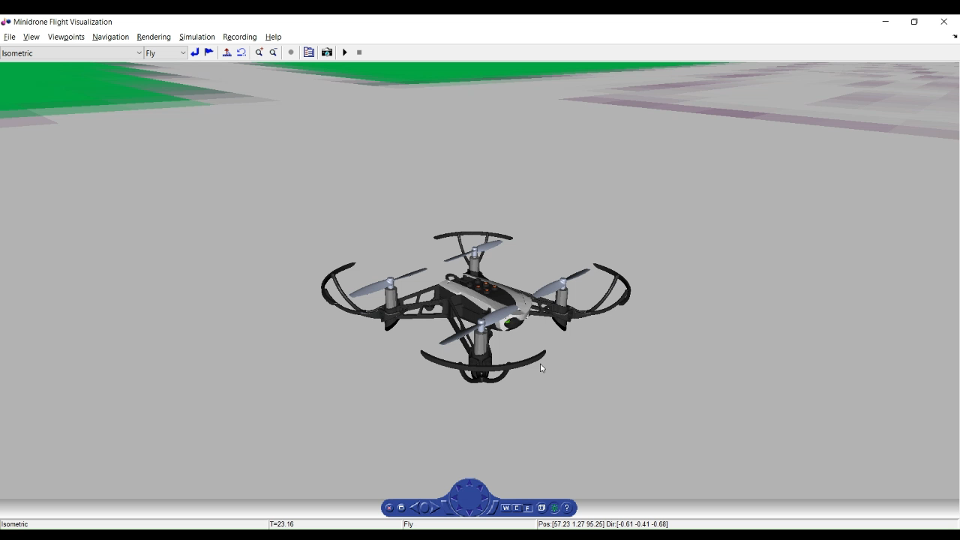
Quadquapter Simulation in Z axis
Team #08

Slide 21
Conclusions
Team #08
We will address some important questions related to our findings and Results as follows:
What are the major design decisions in our implementation?
What did we learn through implementing the project?
Future steps
We tracked Vertical movement along z axis in the quadcopter to create a detailed model using Matlab Simulink.
Learning about Matlab Simulink
Importance of complex control mechanisms for stability
A deeper understanding of aerial vehicle control systems by recognizing the interactions between torques, rotor forces, and the resulting motion.
Construction of the physical system and use the simulated controller design
Consideration of all dynamic factors

Slide 22
Challenges faced
Team #08
System Debugging:
The modeling process for the quadcopter UAV required complex problem-solving within the state-space mode.
For a collective and collaborative approach to fixing errors within the system model, effective communication was essential.
Complex Dynamics Modeling:
Careful calculations of torque, rotor forces, and the interaction between inputs, outputs, and state variables was necessary to capture the quadcopter’s State Space representation.
Careful balancing of these factors to create an accurate model.
Team Scheduling:
Due to team members differing schedules, managing a team for a project like quadcopter UAV system modeling became a challenging.

Slide 23
Future Scope
Team #08
Integration of 3D Motion Control:
Consideration of x, y axes and other dynamics maneuverability in all directions.
Autonomous Navigation:
Allow the quadcopter to move intelligently through complex environments using sensor integration and path planning algorithms.
Obstacle Avoidance and Collision Detection :
To enhance the safety and usability of the quadcopter in crowded or dynamic spaces.
Swarm Coordination:
To perform complex tasks that a single quadcopter cannot accomplish, such as coordinated mapping or search and rescue operations.

Slide 24
References
Team #08
Tahir, Zaid, et al. “State Space System Modeling of a Quad Copter UAV.” Indian Journal of Science and Technology, vol. 9, no. 27, 2016, https://doi.org/10.17485/ijst/2016/v9i27/96613.
Shaun Sawyer (2015). Gain-Scheduled Control of a Quadcopter UAV. UWSpace. http://hdl.handle.net/10012/9488
Johnson, Nicholas Andrew. “Control of a folding quadrotor with a slung load using input shaping.” School of Mechanical Engineering, Georgia Institute of Technology, May 2017.
Shirsat, Aniket Ravindra. “Modeling And Control of a Quadrotor Aircraft UAV.” Arizona State University, May 2015.

Slide 25
Thank You!
Any Questions?

